Slide 1
Fox Fox Foo The program for project groups
Lizzy Jamie
Jay Shoumaker
Joseph Tate
Notes:
Lizzy

Slide 2



Project analysis slide 2
The Engineering Design Process
Identify Problem
Refine
Test
PROJECT
Identify Constraints
Build Prototype ..
Generate Solutions
Plan & Schedule
Evaluate Solutions
Notes:
Lizzy

Slide 3
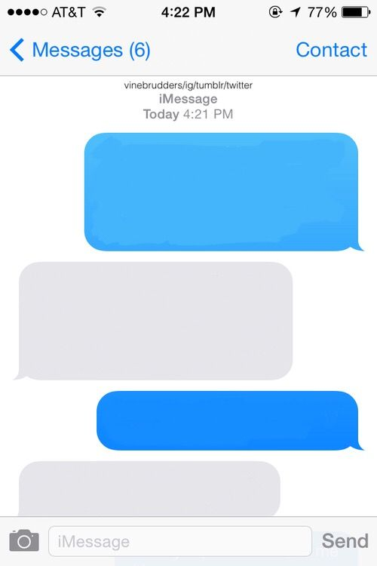
Project analysis slide 3
Identify Problem
Where should we meet to work on our project?
Idk. I don’t want to walk too far
Sample, Faythe. “Blank Image.” PicsArt, 29 July 2017, cdn140.picsart.com/239043789057202.jpg? r1024x1024.
How about Bizzell?
No, I’m in Sarkey’s
Notes:
Lizzy

Slide 4

Project analysis slide 3
Identify Constraints
Deadline: December 2, 2019
Resolve all errors
Program runtime efficiency
Limited presentation space
“Deadline.” 10 Essential Tips To Meeting Deadlines, 7 May 2017, thepitcher.org/10-essential-tips-to-meeting-deadlines/
Notes:
Lizzy

Slide 5
Project analysis slide 3
Generate Solutions
Java code
Maps API – Google Maps API, HERE Maps API
JavaX – GUI applications
Variables – number of group members, method of travel, current locations, preferred places to meet, carpooling
Outputs picture of map
Notes:
Joseph

Slide 6
Project analysis slide 3
Evaluate Solutions
GitHub
Free Maps API – N/A
Time does not allow for:
Input method of travel
Input list of preferred places to meet
Carpooling
Output picture of map
Notes:
Joseph

Slide 7
Project analysis slide 3
Plan & Scheduling
Mondays during Freshman Engineering Experience class
Thursdays at 7:00pm in Bizzell
GitHub – online collaboration
Notes:
Joseph

Slide 8
Project analysis slide 3
Build Prototype
3 classes and a ReadMe file
ReadMe – detailing steps of the engineering design process
Map.java – Create campus locations and brainstorm center point calculator
MapDisplay.java – Creating the initial menu box
Main.java – Create map object
Notes:
Jay

Slide 9
Project analysis slide 3
Build Prototype
Map.java – Finish coordinate locations of major buildings and complete center point functionality
MapDisplay.java – Finish menu box
Main.java – No changes since
Notes:
Jay

Slide 10

Project analysis slide 3
Test
Open Eclipse and run the program!
“Yay Gif.” Giphy, giphy.com/gifs/rainbow-colorful- pinwheel-f7GDJs0SXg1WFXNSNQ
Notes:
Jay

Slide 11
Thank You Any Questions?
Notes:
Jay

Slide 12

Project analysis slide 3
Cited Sources
“1pgmapJune2010.Pdf.” OU Parking Services, June 2010
“Google Maps.” Google Maps, Google, www.google.com/maps/.
User noumenal, and User AugSB.
“Finding the Centre of an Abritary Set of Points in Two Dimensions.” Mathematics Stack Exchange, Stack Overflow, 27 May 2016, math.stackexchange.com/questions/1801867/finding-the-centre-of-an-abritary-set-of-points-in-two-dimensions.
Notes:
Lizzy

Slide 13

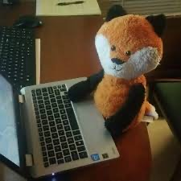
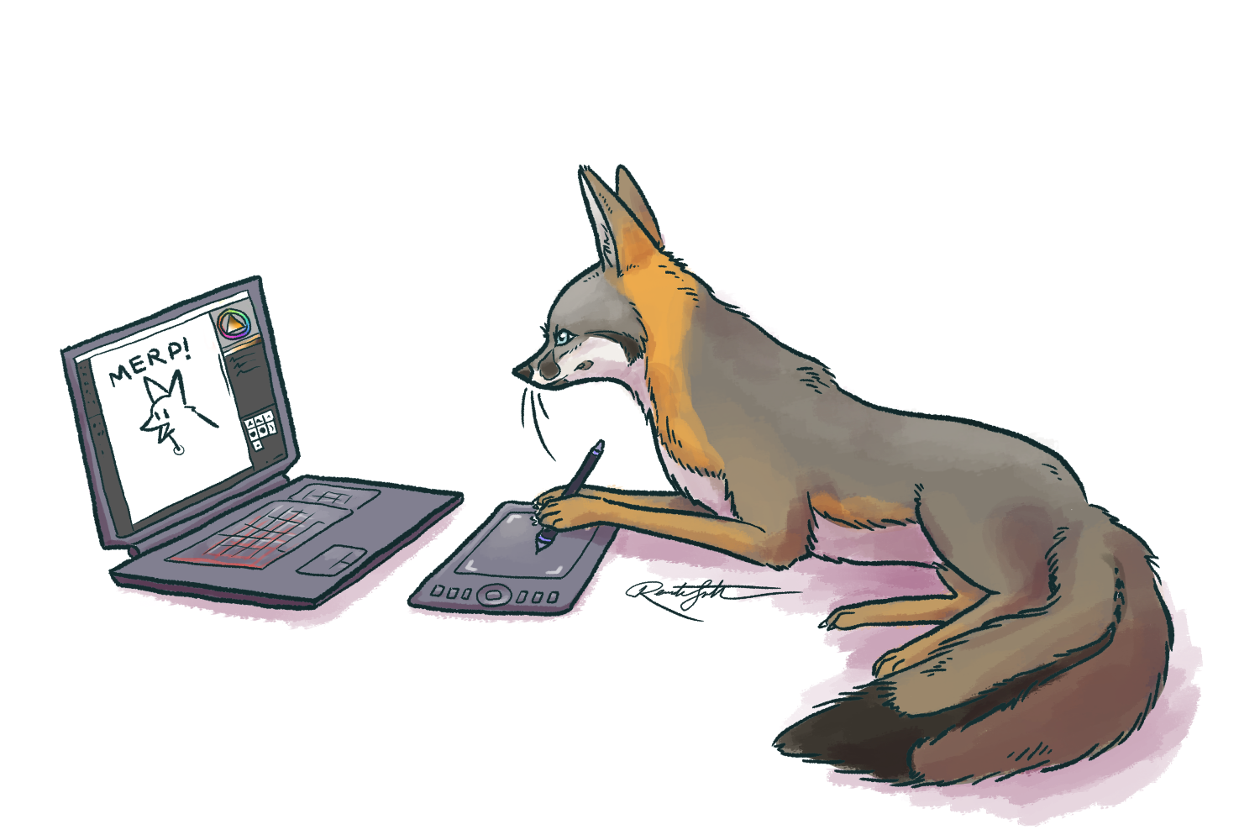
Project analysis slide 3
Fox Fox Foo
Lizzy Jamie – elizabeth.l.jamie-1@ou.edu
Jay Shoumaker – jay.w.shoumaker-1@ou.edu
Joseph Tate – joseph.a.tate-1@ou.edu
Table Space – enough to fit two laptops
Floor Space – none required
Electrical Outlet – yes (preferably two)
Each member should* be able to attend the Freshman Showcase
“Fox Pic on Twitter.” Twitter, www.google.com/imgres?imgurl=https%3A%2F%2Fpbs.twimg.com%2Fprofile_images%2F757559437443858432%2FxtCr7LF6_400x400.jpg&imgrefurl=https%3A%2F%2Ftwitter.com%2FFox_Pick%2Fstatus%2F1117183612703604769&tbnid=0qAm8Bgcm5920M&vet=12ahUKEwj26q2kuYPmAhUF36wKHZdODIUQMygKegUIARDjAQ..i&docid=xM4Z4JZFq3fhHM&w=400&h=400&itg=1&q=fox%20on%20computer&ved=2ahUKEwj26q2kuYPmAhUF36wKHZdODIUQMygKegUIARDjAQ.
Programmer Devil com- Drawception. www.google. /imgres?imgurl=https%3A%2F%2Fcdn.drawception.com%2Fdrawings%2FNACPbv0687.png&imgrefurl=https%3A%2F%2Fdrawception.com%2Fgame%2FfCGLG29xwF%2Fprogrammer-devil%2F&tbnid=WAREVz4-YO1DgM&vet=12ahUKEwj26q2kuYPmAhUF36wKHZdODIUQMygQegUIARDvAQ..i&docid=oxFIY45kHD54KM&w=300&h=250&q=fox%20on%20computer&ved=2ahUKEwj26q2kuYPmAhUF36wKHZdODIUQMygQegUIARDvAQ.
Confused Fox - The Vulpine Club. www.google.com/imgres?imgurl=https%3A%2F%2Fassets.vulpine.club%2Fmedia_attachments%2Ffiles%2F002%2F322%2F012%2Foriginal%2Fad350dee03bb3fe2.png&imgrefurl=https%3A%2F%2Fvulpine.club%2F%40jafx&tbnid=U7MIFc1ZBnyRgM&vet=12ahUKEwj26q2kuYPmAhUF36wKHZdODIUQMygLegUIARDlAQ..i&docid=eMN0_gR0OAsxQM&w=1500&h=1000&q=fox%20on%20computer&ved=2ahUKEwj26q2kuYPmAhUF36wKHZdODIUQMygLegUIARDlAQ.
Notes:
Lizzy – 100% free
Jay – Free after 1:20pm
Joseph - unknown

Slide 14
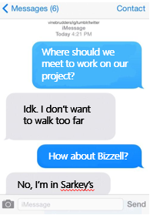
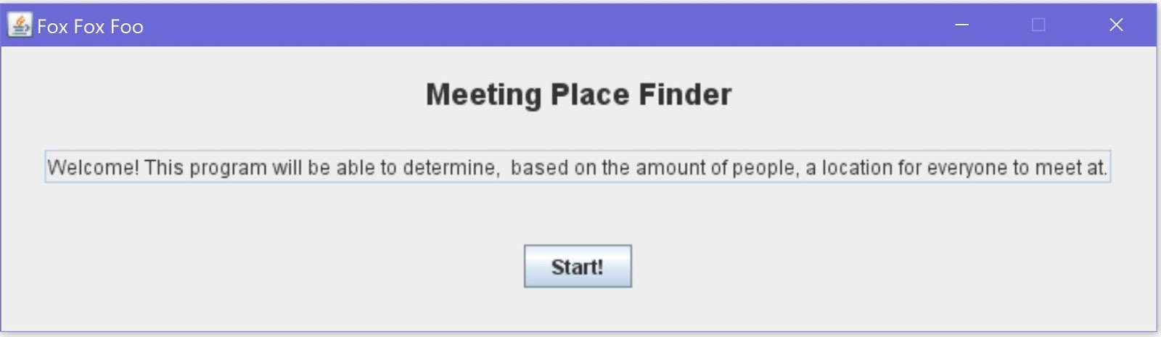
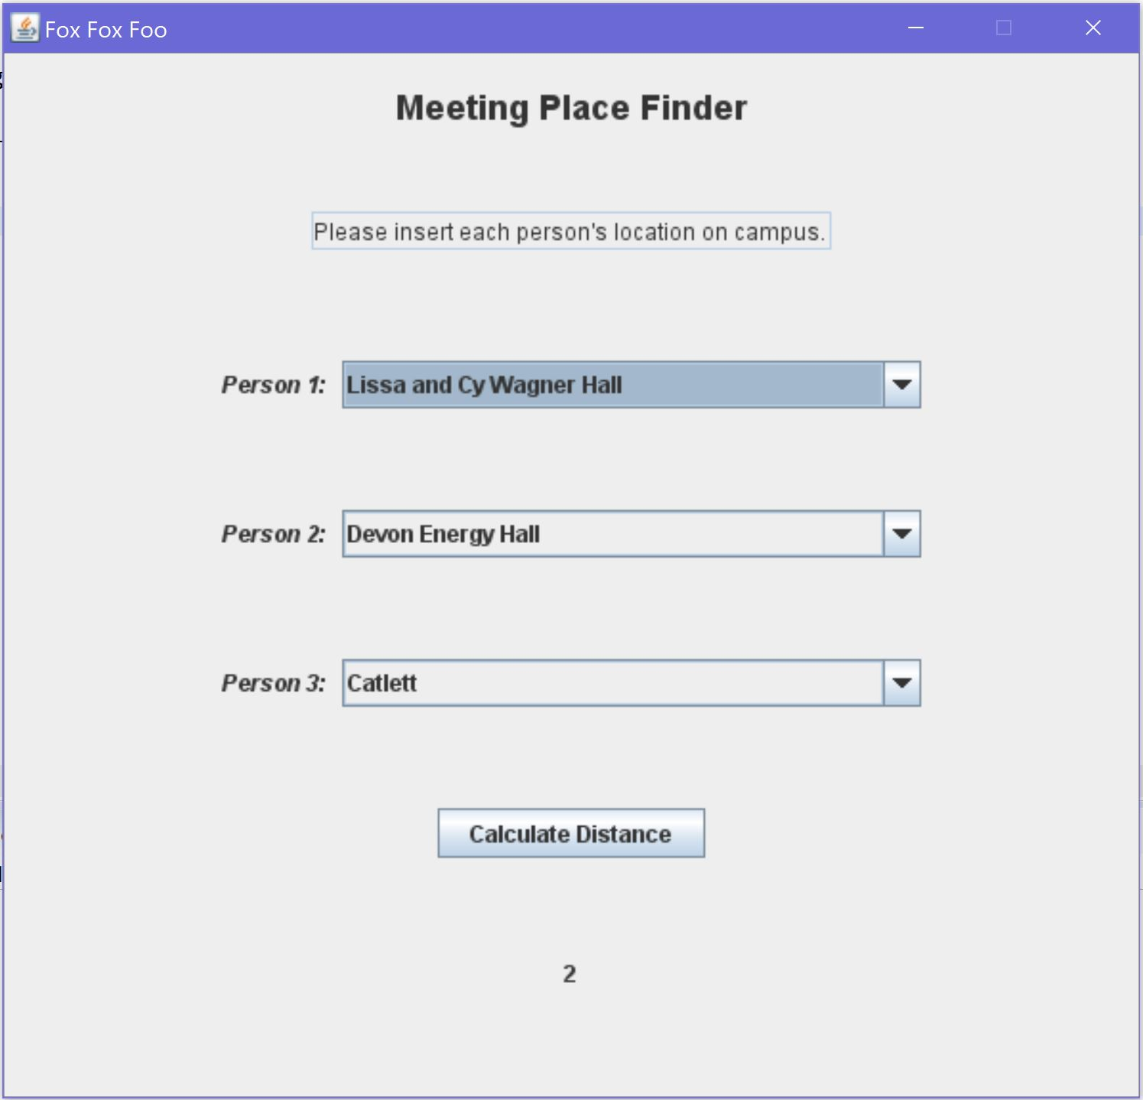
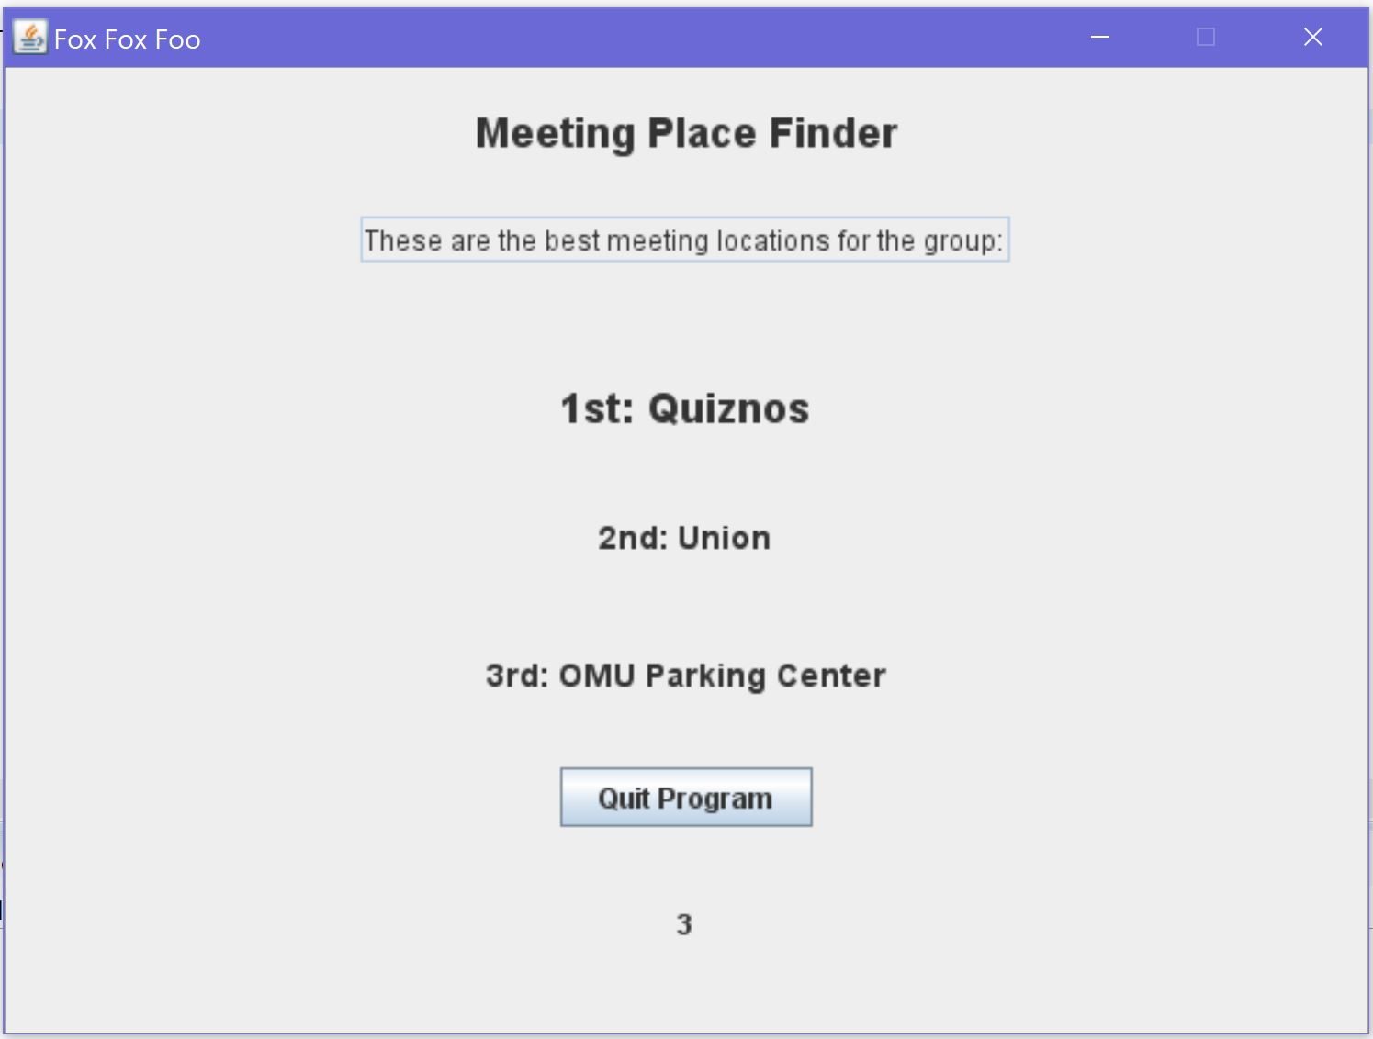
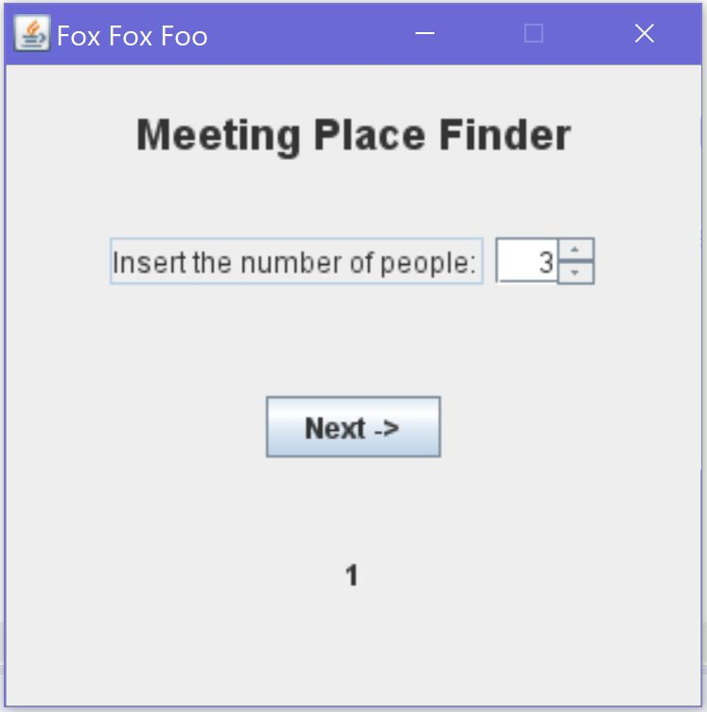
Fox Fox Foo
The program for project groups
Identify Problem
Identify Constraints
Generate Solutions
Evaluate Solutions
Build Prototype
- GitHub
- Free Maps API – N/A
- Time does not allow for:
- Input method of travel
- Input list of preferred places to meet
- Carpooling
- Output picture of map
Plan & Schedule
- Map.java – Finish coordinate locations of major buildings and complete center point functionality
- MapDisplay.java – Finish menu box
- Main.java – No changes since
- Deadline: December 2, 2019
- Resolve all errors
- Program runtime efficiency
- Limited presentation space
- Java code
- Maps API – Google Maps API, HERE Maps API
- JavaX – GUI applications
- Variables – number of group members, method of travel, current locations, preferred places to meet, carpooling
-Outputs picture of map
- Mondays during Freshman Engineering Experience class
- Thursdays at 7:00pm in Bizzell
- GitHub – online collaboration
Test

